Slide 1

Twitter Sentiment Analysis
NLP Project

Slide 2
Problem Statement
6000 people take to Twitter every minute to express an opinion, or share a piece of information however few number of these tweets can be problematic.
By creating a sentiment analysis algorithm that can regulate problematic content on a social media platform like twitter could help to solve this problem.
So the task is to develop a sentiment analysis algorithm to identify and flag problematic Tweets on Twitter.

Slide 3
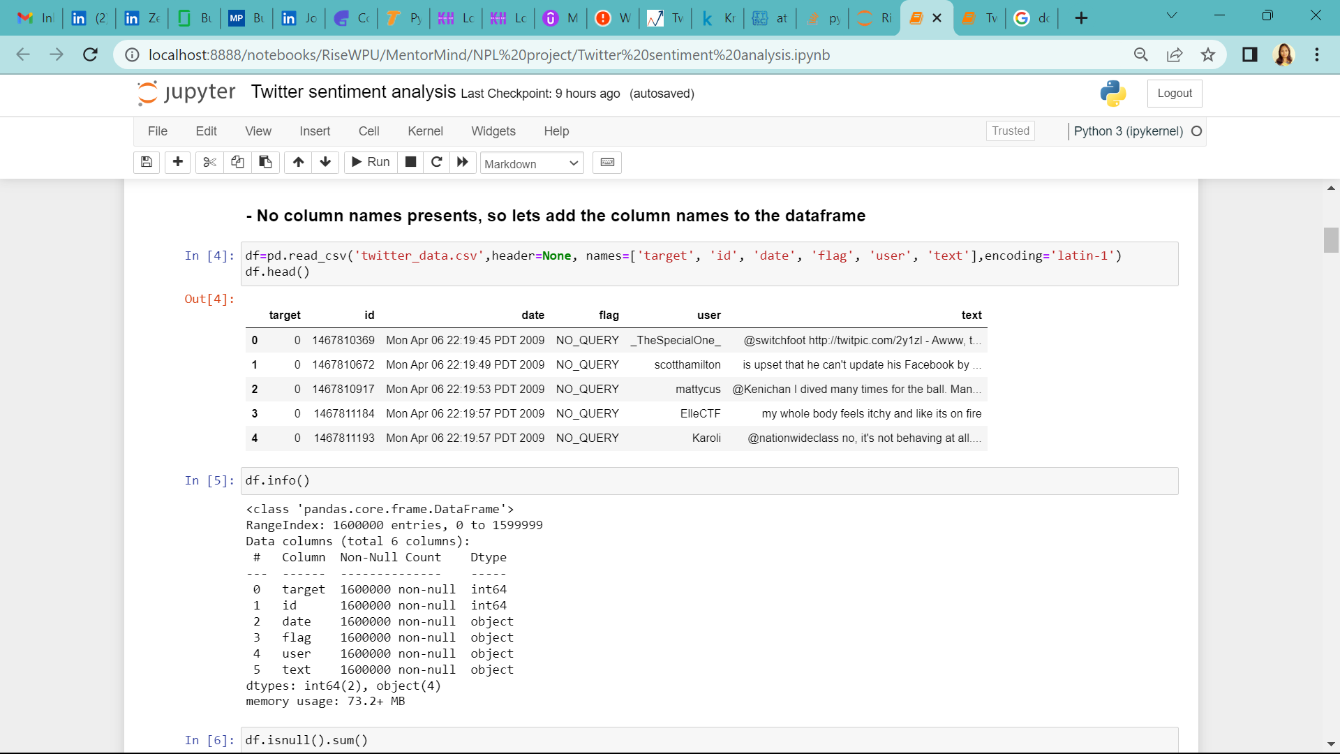
Getting started with data
The dataset has total 6 columns, target, id, date, flag, user, text
Target: This is the target column which has 2 labels 0, 4
id: This column contains the account ids of the twitter user
date: This column gives the information about the date & time of the twit being posted
flag: If any flag being tagged to the twit
user: The twitter handle of the user
text: It contains the twit’s text

Slide 4
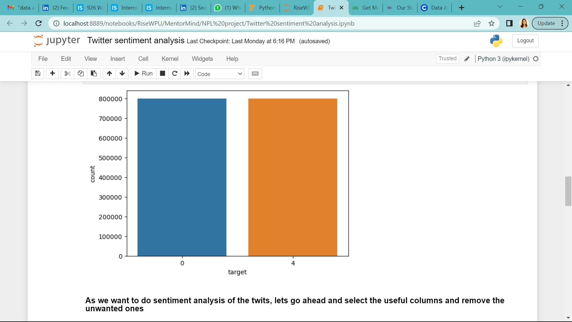
Exploratory data analysis findings
There are no missing values
The shape of dataset is (1600000, 6), which means it contains 6 columns and 1600000 rows
No duplicate values found
The target column has 2 categorical values
From the no. of count of the two classes, we conclude that this column is balanced

Slide 5
Pre-processing the text
Dropping unwanted columns 'id’, 'date’, 'flag’, 'user’
Replacing class ‘4’ by ‘1’ in target variable for better understanding
Case normalization & removing numeric characters
Removing Unicode characters and numbers
Removing stop words using NLTK
Performing stemming
Performing lemmatization

Slide 6
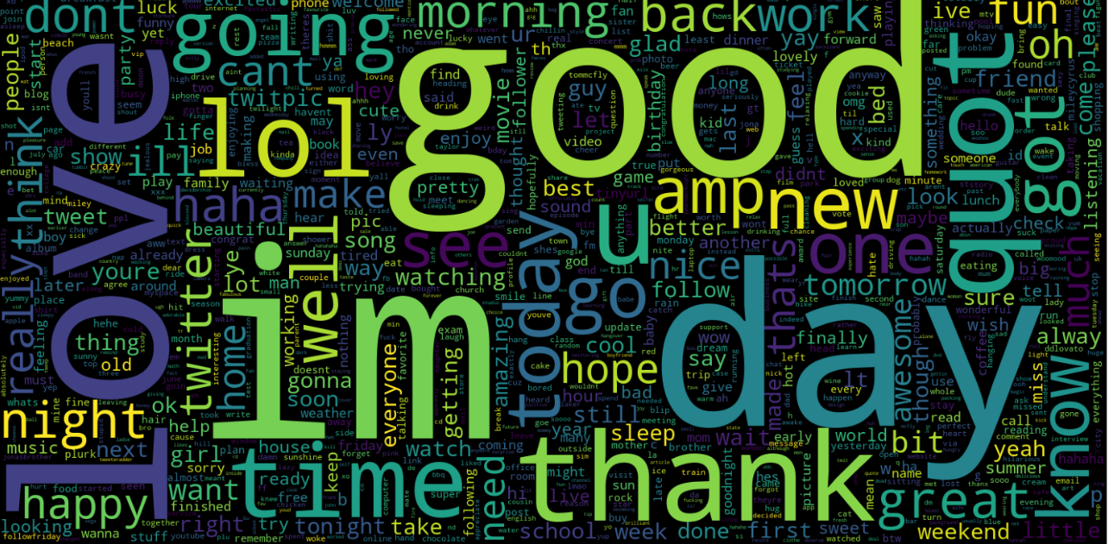
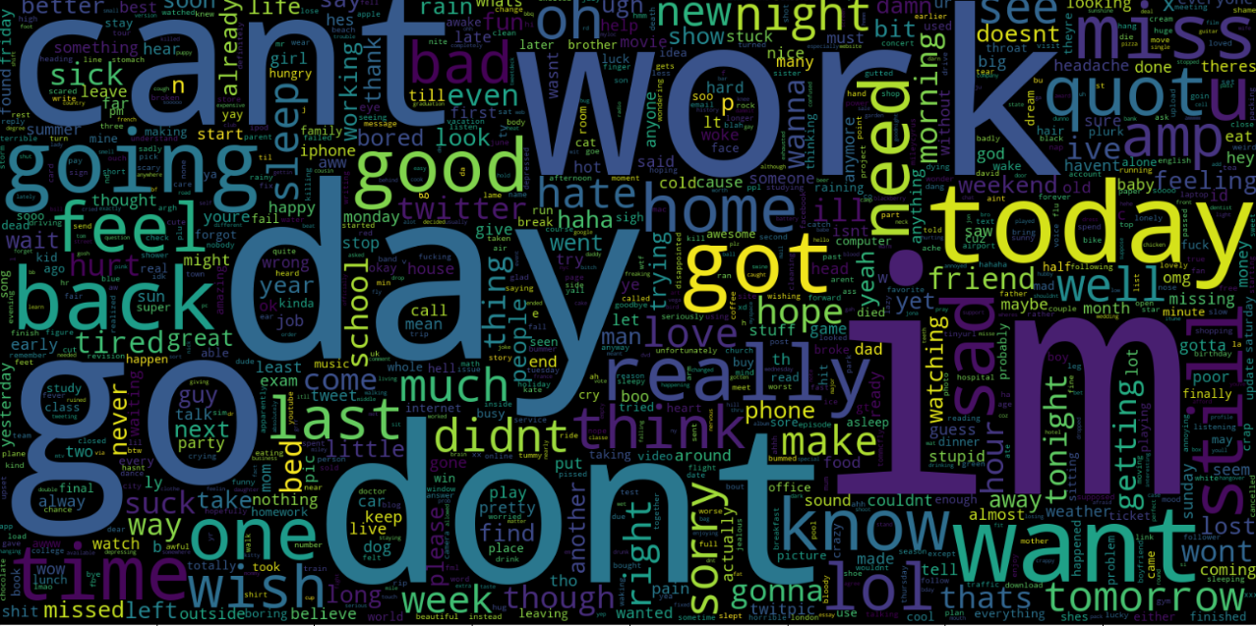
Visualization
Word cloud for Positive Sentiments
Word cloud for Negative Sentiments

Slide 7
Preparing data for model creation
Tokenization
Splitting the data into train & test
Using TF-IDF vectorizer method for transforming the text into feature vectors or machine readable format
Model creations using 3 different algorithms
Bernoulli Naïve Bayes
Support Vector Machines
Logistic Regression

Slide 8
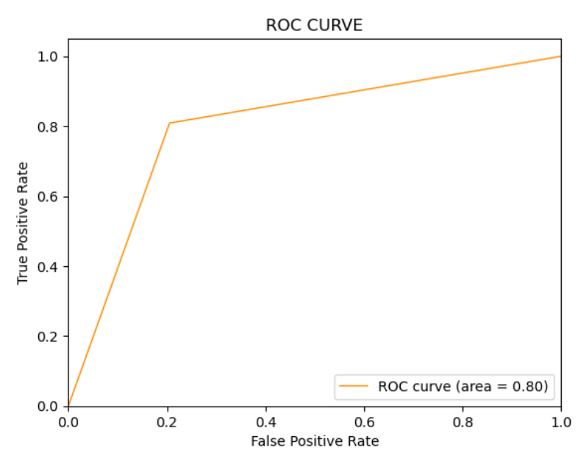
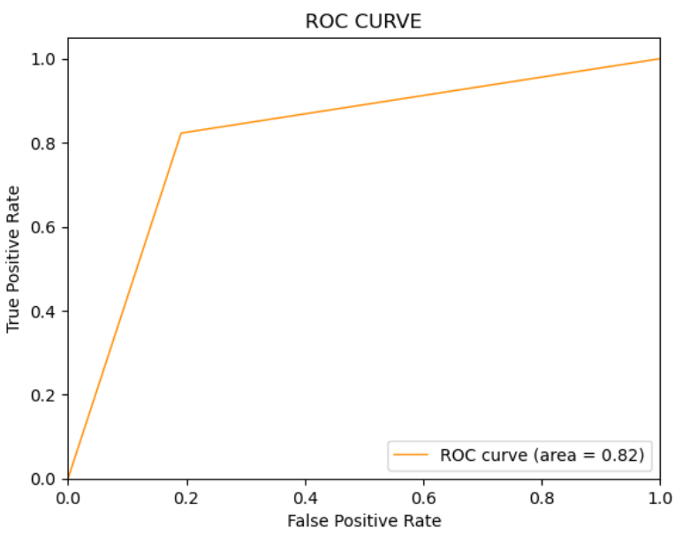
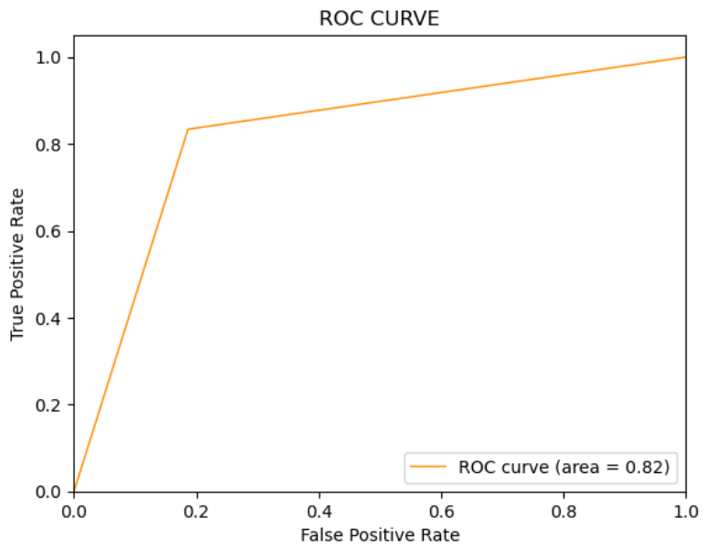
Model Evaluation
Algorithm | Accuracy
Bernoulli Naïve Bayes | 80%
Support Vector Machines | 82%
Logistic Regression | 82%
Bernoulli Naive Bayes
Support Vector Machine
Logical Regression

Slide 9
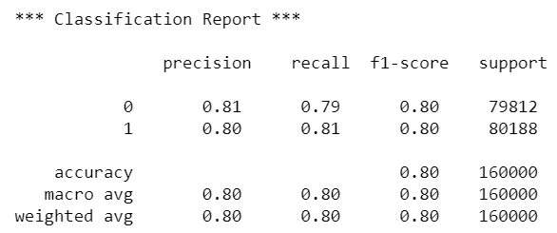
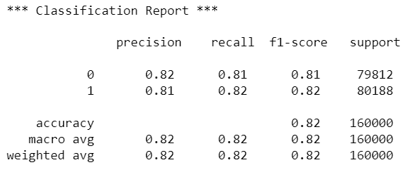
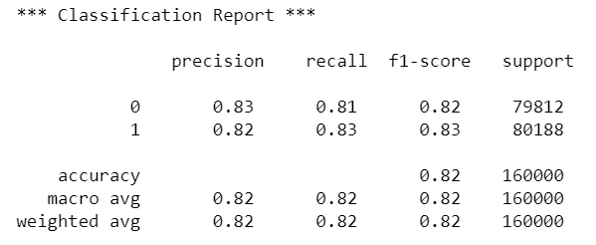
Classification Report
Bernoulli Naive Bayes
Support Vector Machine
Logical Regression
Comparing all 3 models, we can observe,
SVM & logistic regression have better accuracy than Naïve Bayes
If we look at the classification report, logistic regression is slightly better than SVM
So, post hyper tunning the logistic regression, I think it can perform much better

